Slide 1
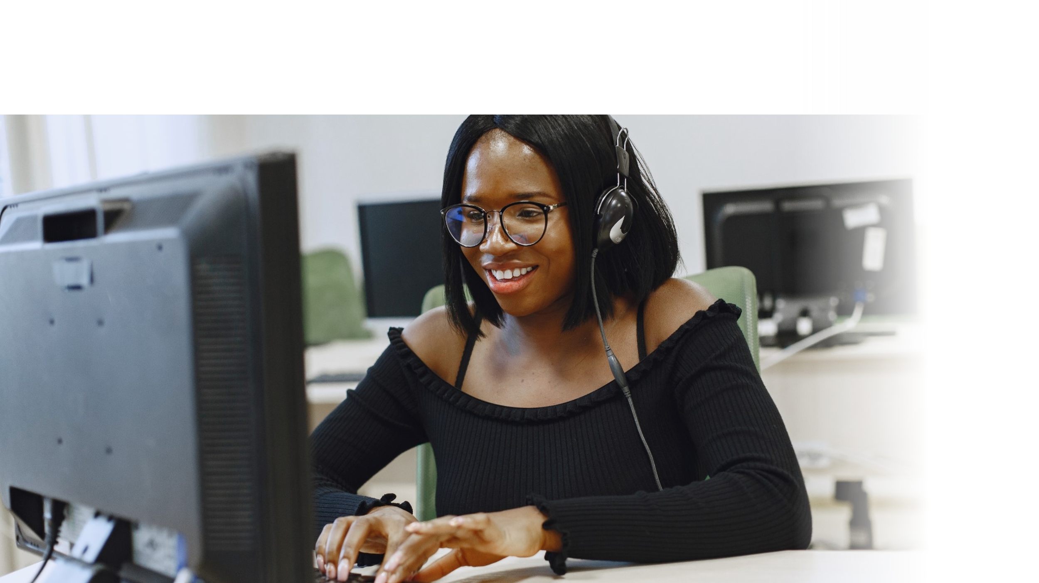



DIGITAL LITERACY
SKILLS
ADVANCED USERS

Slide 2
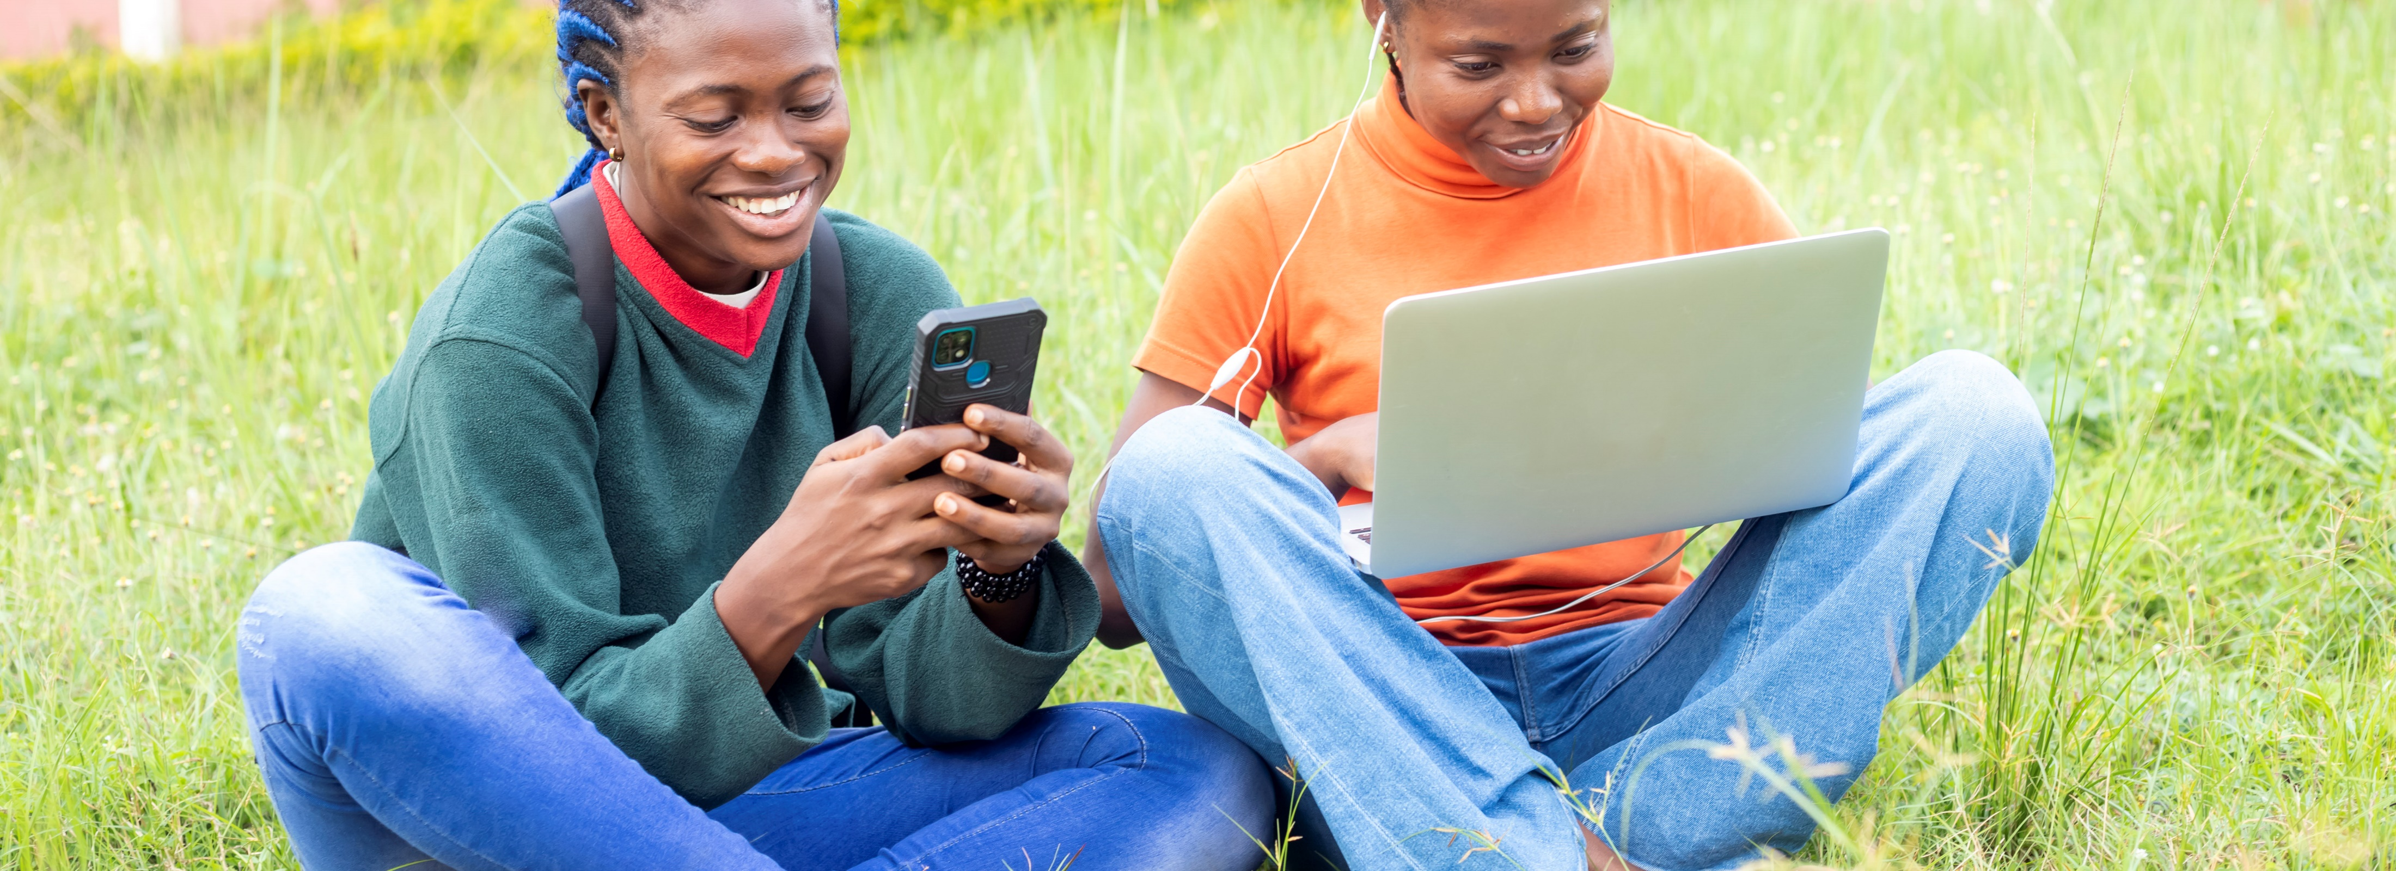
Module 5
Safety and security

Slide 3

2
Unit 2: Protecting personal data and privacy

Slide 4
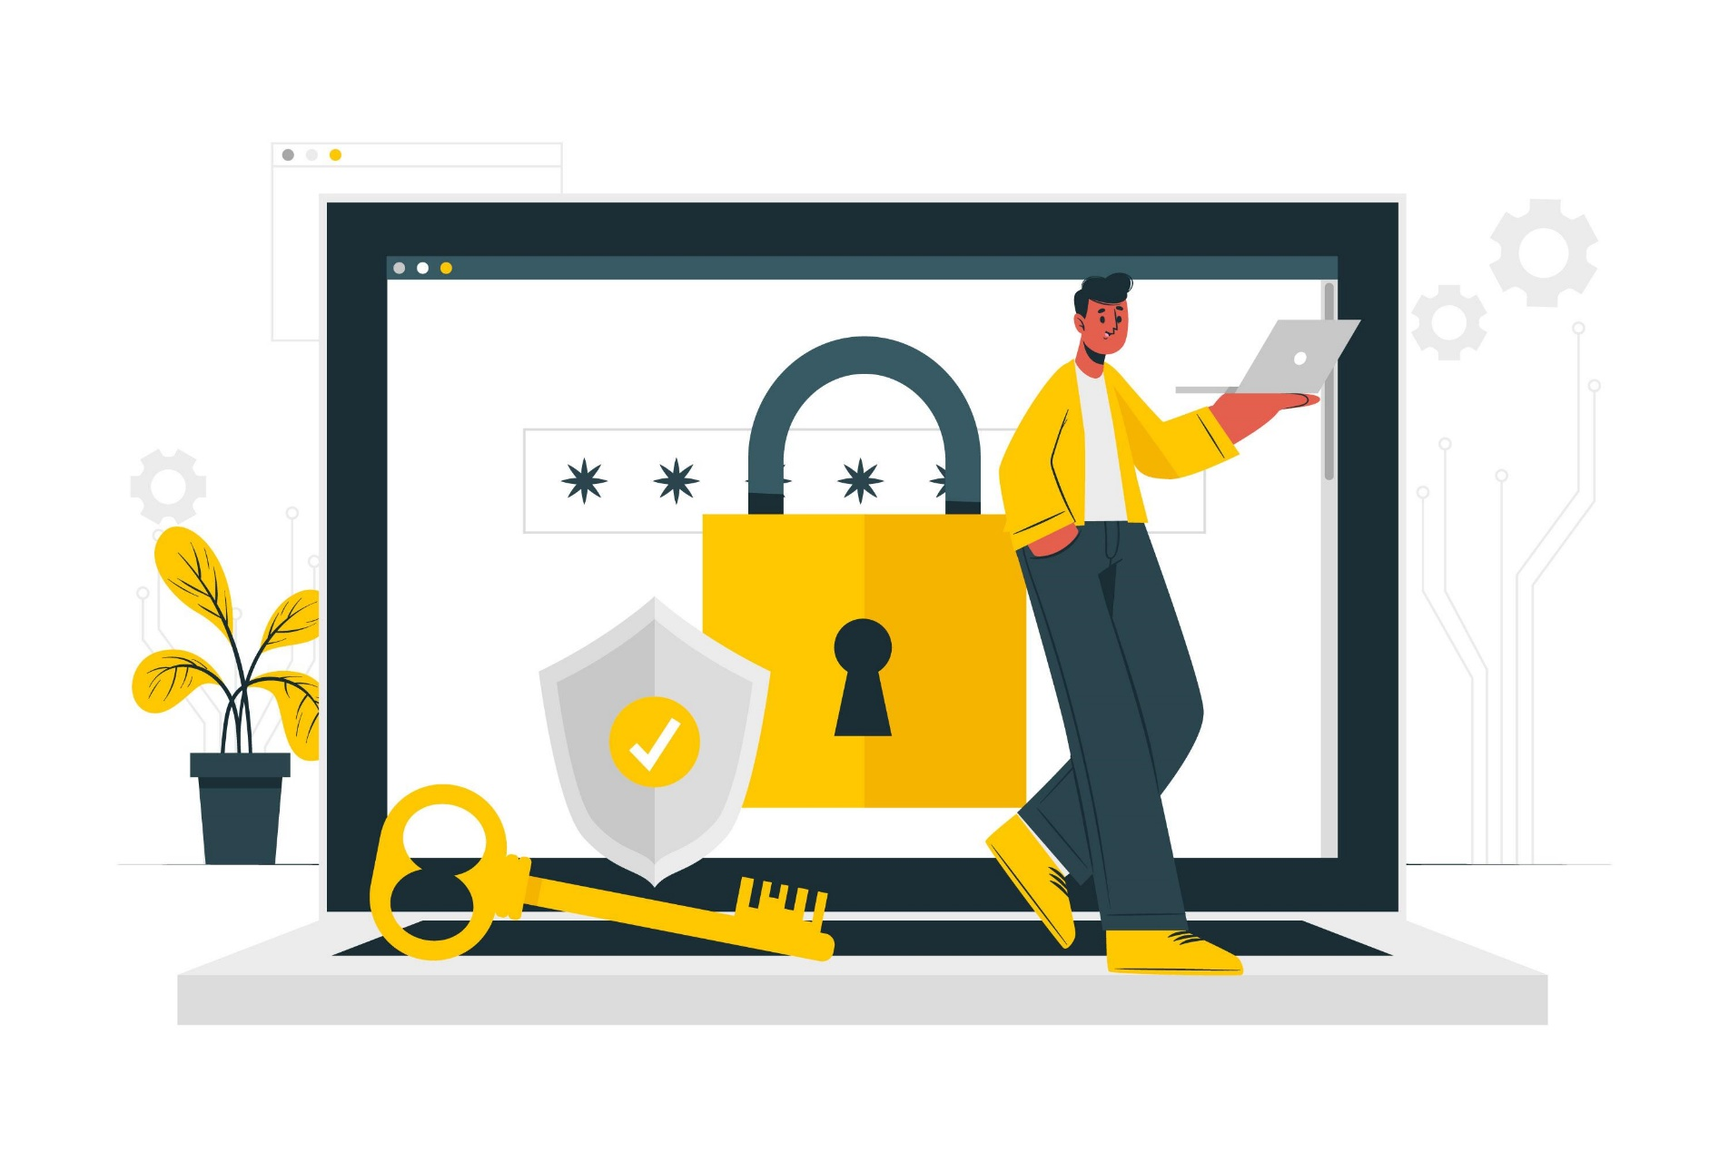
Protecting yourself online
How can you protect yourself?
Limit the amount of personal information you share.
Remember that the internet is a public resource.
Be wary of strangers.
Be sceptical.
Evaluate your settings.
Be wary of third-party applications.
Check privacy policies.

Slide 5
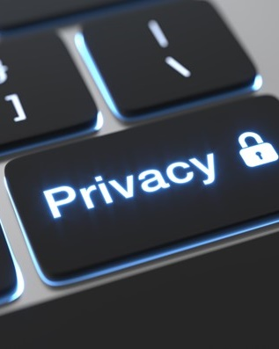
Guidelines for sharing personal information
View the internet as a novel, not a diary.
Limit the amount of personal information you post.
Realize that you cannot take it back.
You are not anonymous.

Slide 6
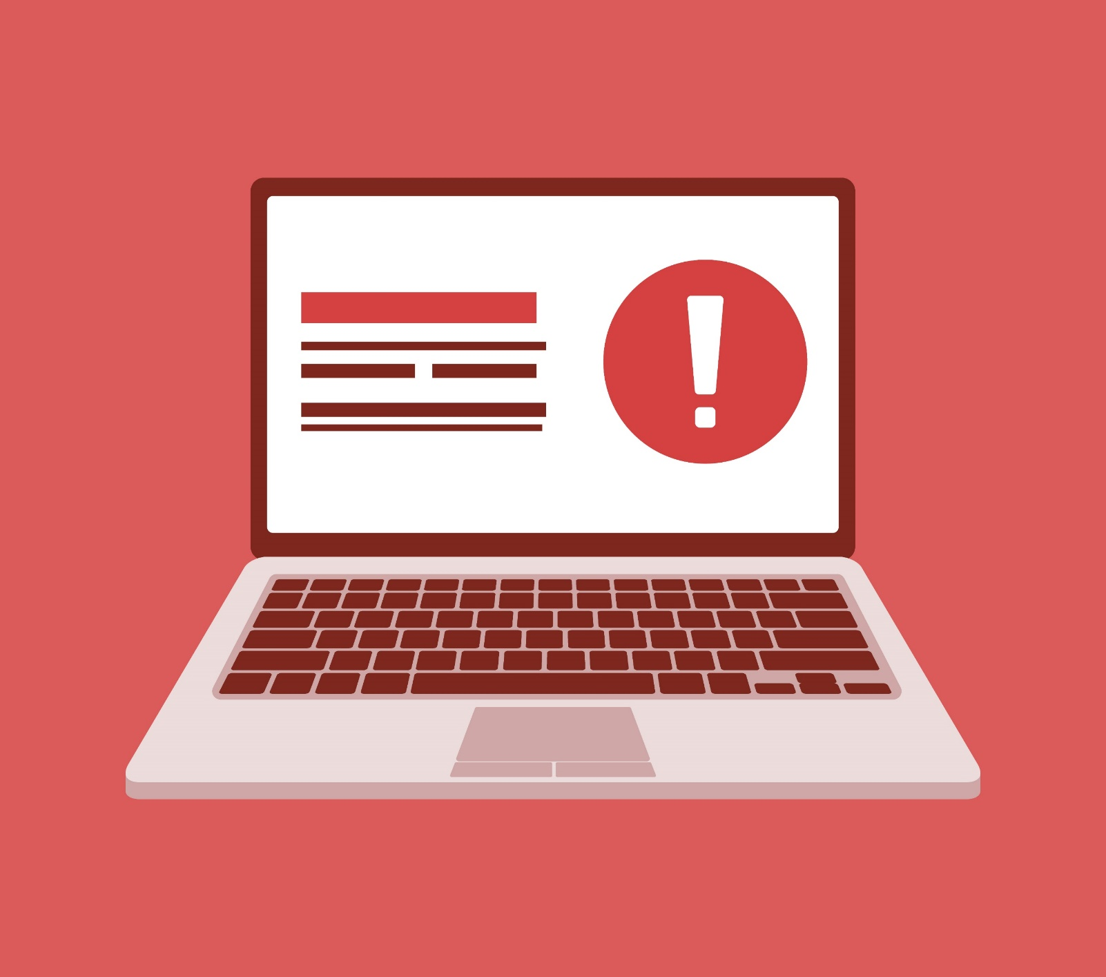
Reduce email threats
Phishing emails are the most common attack routes.
A phishing email is is sent to you pretending to be for a certain purpose, to get a response from you.
It relies on you making a mistake and answering the email or clicking on a link in the email.
There are many indicators that can help you to identify a phishing email.
Banks will never send an email with a link to update something on your account.
Check for spelling mistakes or strange addresses.
Do not click on links from emails.

Slide 7
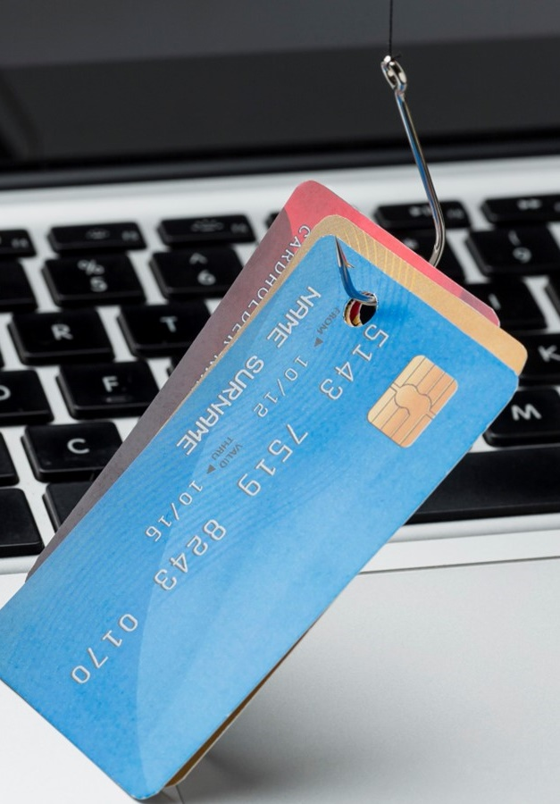
Avoiding social engineering and phishing attacks
Social engineering attacks
Phishing attacks
Vishing attacks
Smishing attacks

Slide 8
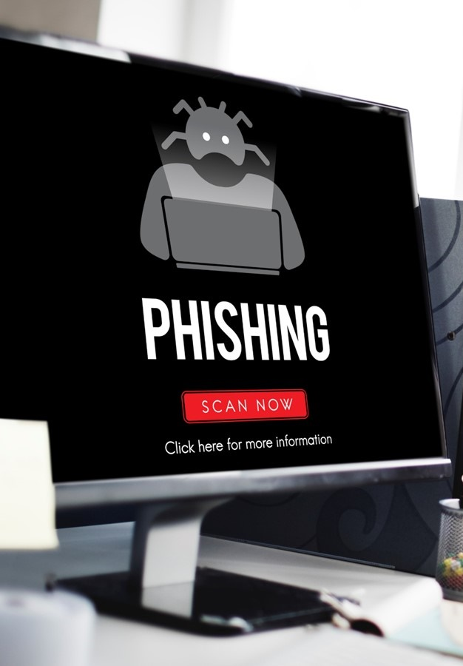
Common indicators of phishing attempts
Be aware of these indicators:
Suspicious sender’s email address
Generic greetings and signatures
Spoofed hyperlinks and websites
Spelling and layout
Suspicious attachments

Slide 9
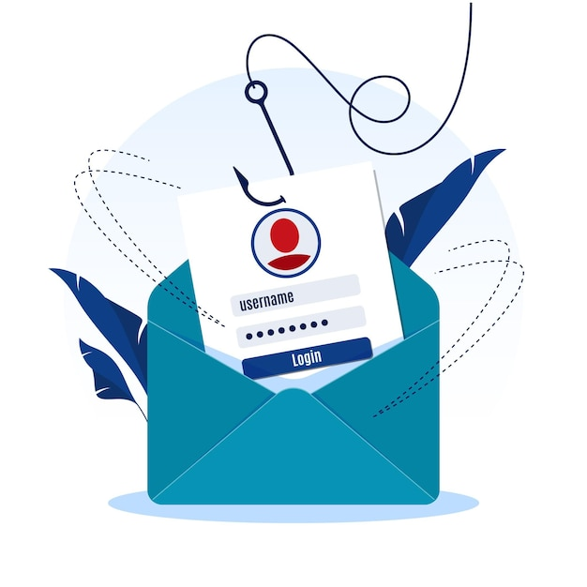

Avoid being a victim
Be suspicious of unsolicited phone calls, visits, or email messages.
Do not provide personal information.
Do not put personal or financial information in emails.
Don't send sensitive information over the internet.
Pay attention to the Uniform Resource Locator (URL) of a website.
When making a payment, look for a closed padlock icon.
Try to verify email requests.
Install and maintain filters.
Enforce multi-factor authentication (MFA).

Slide 10

Security implications of social network sites
When deciding how much information to reveal because:
the internet provides a sense of anonymity
the lack of physical interaction provides a false sense of security
they tailor the information for their friends to read, forgetting that others may see it
they want to offer insights to impress potential friends or associates.

Slide 11

How information is used
Organizations use the information that is gathered to generate statistics about their sites
The information is also used for marketing.
Some sites may collect your information for malicious purposes.

Slide 12

How information is used
The attackers can steal your identity and use and abuse your personal information for financial gain.
Attackers may use this type of information once then sell it to other people.
The attackers can alter the security settings on your computer to access and use your computer for other malicious activity.

Slide 13
Skills to practise
Review privacy policies
Complete an internet search to find out the recommended privacy settings for a laptop, tablet, and smartphone.
Make notes on how to apply these settings on your own device.
Find out about data protection laws
Complete an internet search and find out what data protection laws apply in Uganda. For example, is it legal for a bank to sell customers’ personal details like names, addresses, phone numbers and email addresses?
Research why data protection laws are needed and what would happen if they did not exist.

Slide 14
All back covers should include
contact information of the section
producing the work.
© United Nations Children’s Fund (UNICEF) [month and year of publication]

